Slide 1

Lander University Film Festival Campaign

Slide 2
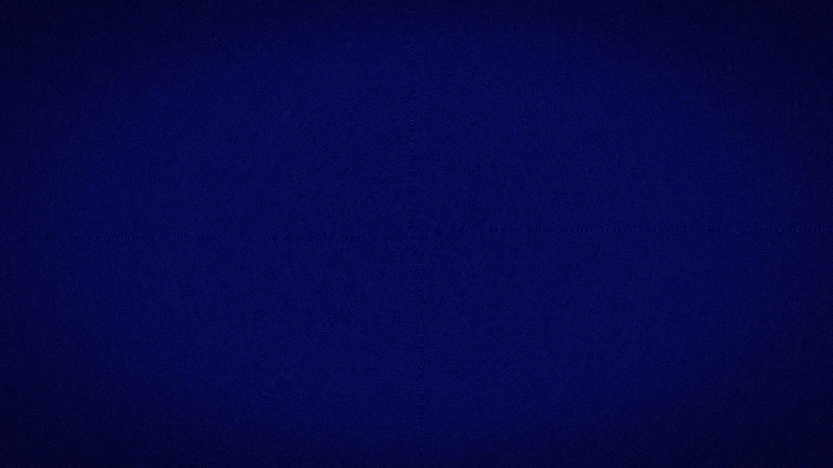
Overview
Campaign Information
Newspaper/Flyers
Radio
Social Media Video Overview
Inspiration
Production Calendar
Talent
Wardrobe/Props/Makeup
Locations

Slide 3


Production Company | Client
Bearcat Cinematics | Lander University Media Department 15th Annual Film Festival
1234 Grace Street Greenwood, South Carolina 29649 | 320 Stanley Avenue Greenwood, South Carolina 29649
Alyssa Campbell Kiersten Thatcher | Cory Carpenter Robert Stevenson

Slide 4
Newspapers, Flyers, Brochures, and Radio Campaign

Slide 5
Newspapers and Flyers
We will have a couple different styles of flyers to catch the public eye. The one in the newspaper that contains information underneath it will be simple. For the Forum, it'll be more artistic. For the flyers, they will be even more eye-catching so they attract the students that would be interested in the program.

Slide 6



Newspapers and Flyers
Newspaper insert, information underneath
Forum insert,
Information underneath
Forum insert for after competition aspect is closed

Slide 7
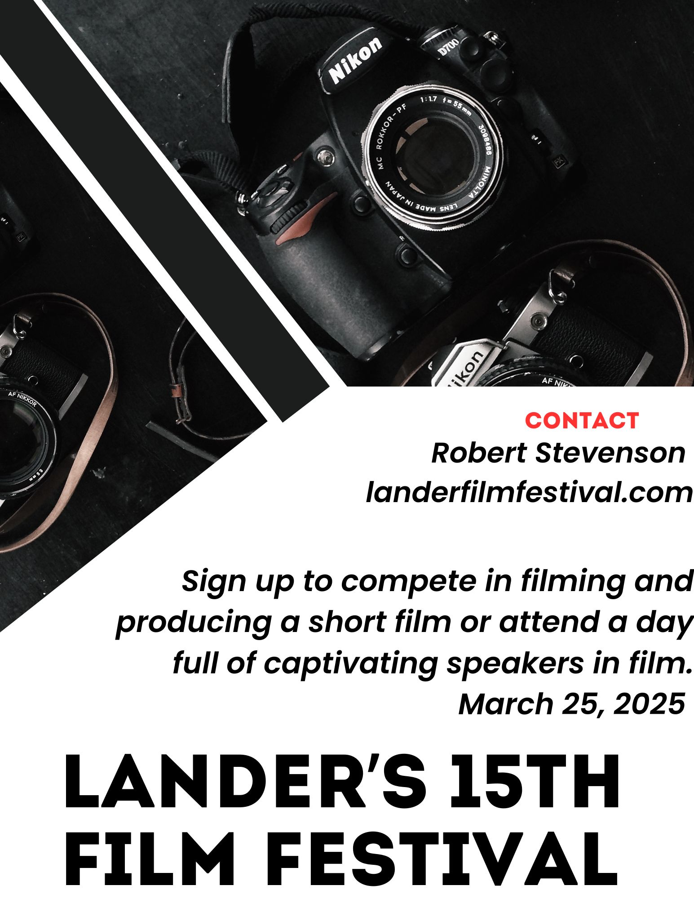
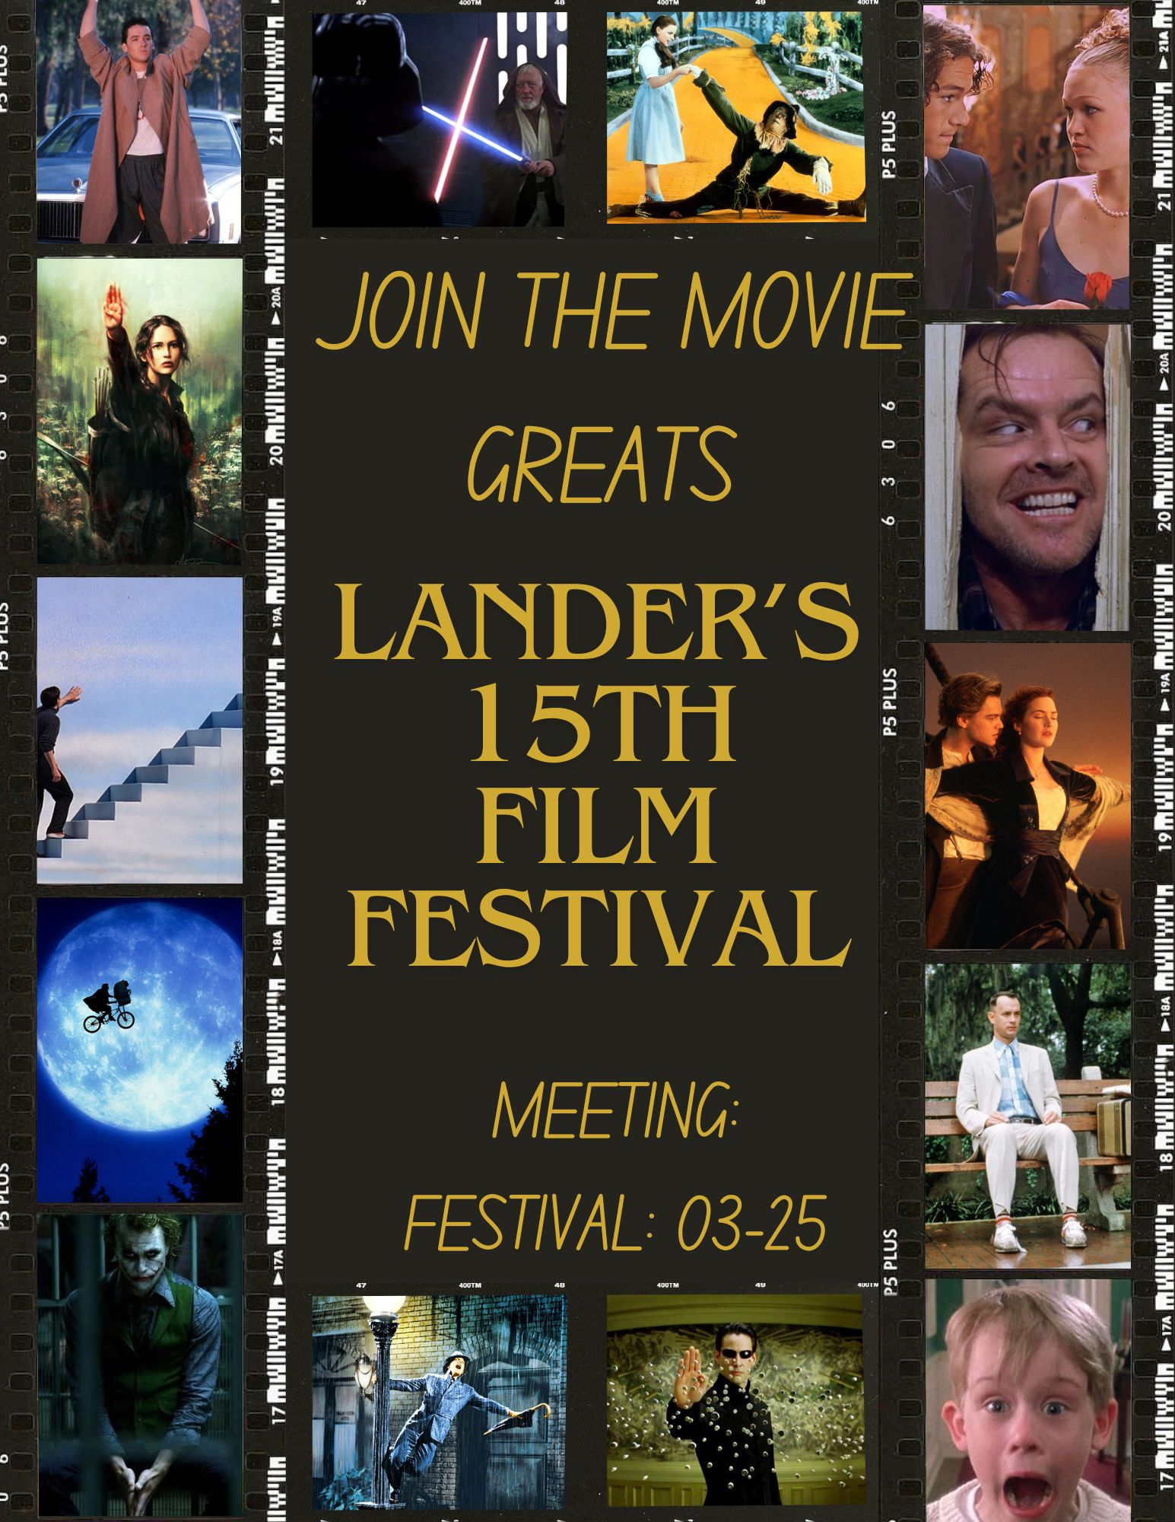
Newspapers and Flyers
Example posters for the English and Media halls

Slide 8
Brochures
The brochures exist to give the information about the day. They will be simple designs with just the film festival logo on the front. They will contain all the information regarding the day, speakers, times, and all other necessary information.
These will be handed out and passed out around town, as well as given to local businesses to give to their clients and customers.

Slide 9
Radio
The radio ad will be fairly simple. It will just be a simple "Join us for the Lander Film Festival on March 25th for a day full of keynote speakers in film and supporting local, undiscovered talent. To compete, attend the meeting on _____. There are high school, college, and open divisions. For more information, go to landerfilmfestival.com"

Slide 10
Social Media Campaign

Slide 11
Social Media Video Overview
Our social media campaign is composed of three videos, two posts, and a countdown story.
The first video is designed to be a soft launch, posted January 4, 2025. For this specific video, we can just video fireworks or use stock footage. The caption will just say “HAPPY NEW YEAR, BEARCATS! Are you looking for something to do this year? Consider competing in or attending our film festival this March. More details to come.”

Slide 12
Social Media Video Overview
The second video is designed to generate student interest in the fun side of producing with their friends, to be posted on February 1st. The shot will begin in the CC auditorium, with a student watching old film festival footage. It will then shift to outside on the stage behind Laura Lander and the field in front of Laura Lander, where the same student is filming with a group of friends. It is designed to look fun and lighthearted. Then, we will get a shot of the Laura Lander building that matches the logo, fade into the Film Festival logo, and caption the video: “Don’t just SAY you can make a film! Make a film! Make the memories! Compete in our film festival next month!”

Slide 13
Social Media Video Overview
The next thing will be the social media posts, to be released February 15th and February 22nd. The first will be the film festival flyer, with meeting information in the caption. The second will be a flyer for the required meeting in which students are told what to include in their film.

Slide 14
Social Media Video Overview
The third video is designed to generate interested in following dreams and producing a film, to be posted on March 1st. The shot will begin with a black screen reading “every kid has dreams”. We will see kids in a classroom telling the camera their dreams of being famous and working on movies. The camera will then cut to students of the same age, gender, etc. working on a project for the film festival, as if they are the same students grown up. Screen fades to black, reads “make younger you proud” followed by the film festival logo. The caption holds interest meeting and competition dates and details.

Slide 15
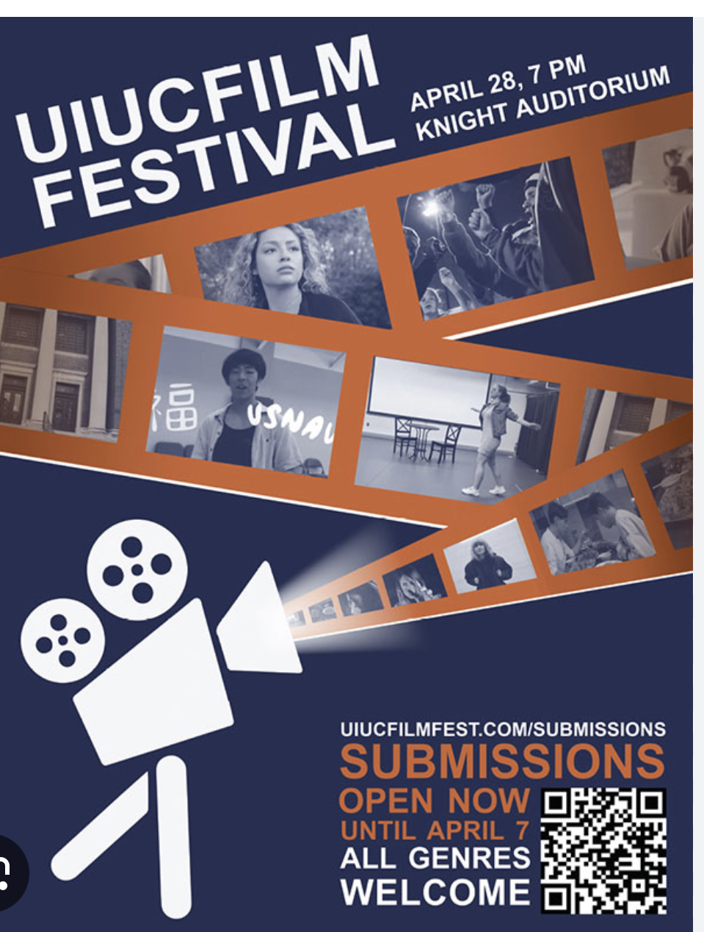
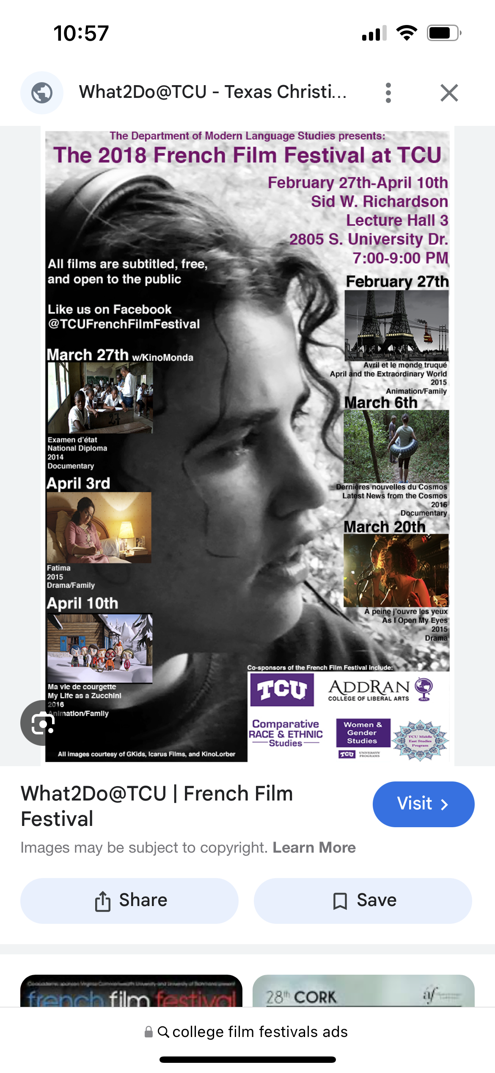
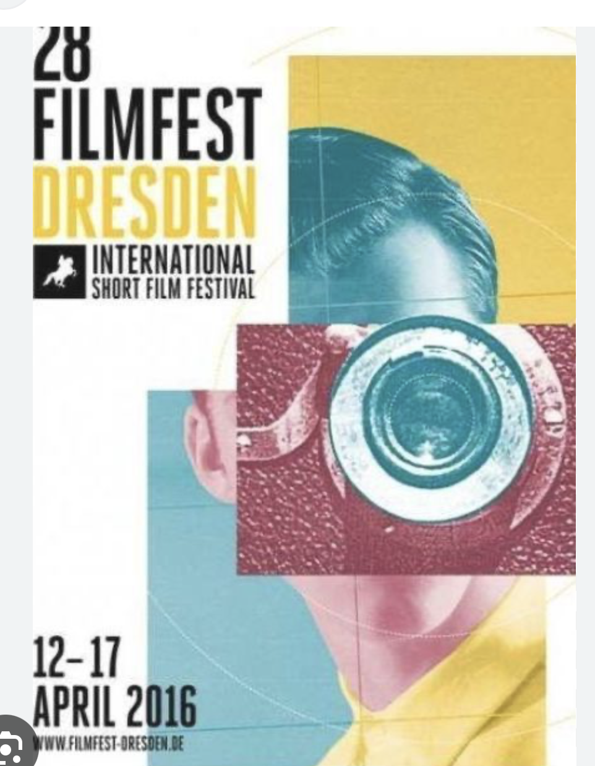
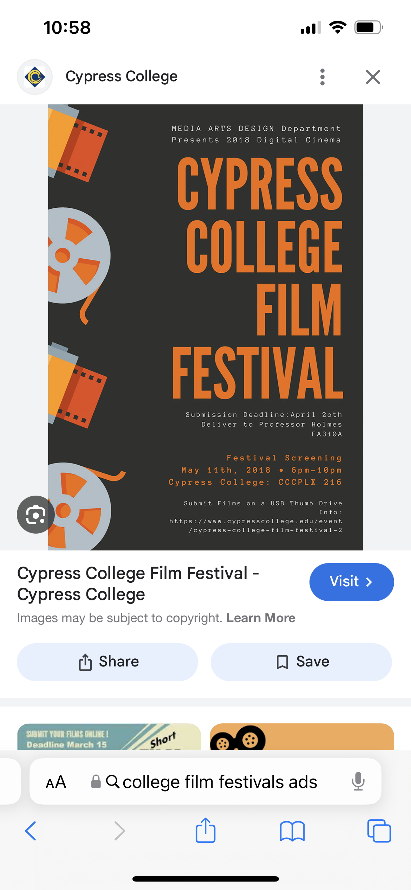
Inspirations

Slide 16
Inspirations
[10 Hours] Fireworks NORMAL SPEED - Video & Audio [1080HD] SlowTV (youtube.com) (generic fireworks video)
NF - When I Grow Up (youtube.com) (the intro is the little kids, but I would want ours to be brighter and more hopeful)

Slide 17
Production Calendar and Timetables
Video one can be shot on New Years' Eve and still edited in time for the fourth
Videos two and three will be shot in December and edited in January. This way, any reshots will have time to be completed.

Slide 18
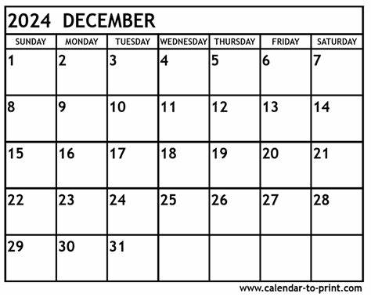
Production Calendar and Timetables
Lander
Grads
Video Two filming
Video Two and Three
Filming
Video Three Filming
Off for Christmas and New Years

Slide 19
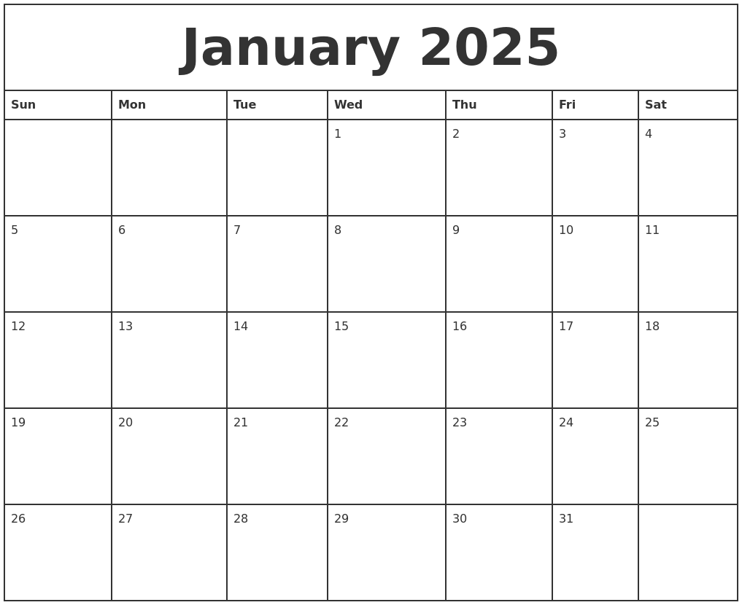

Production Calendar and Timetables
Editing for Video Two
Editing for Video Three
Any necessary reshooting and reediting for either video

Slide 20
Talent
Video One: N/A
Video Two: 2-4 college students, CC auditorium full of extra students and professors
Video Three: 2-4 elementary students
2-4 college students that look like they could be the elementary students grown up

Slide 21
Wardrobe, Props, Makeup
Video One: N/A
Video Two:
Wardrobe and makeup: Simple, jeans and t-shirt type clothing,
stereotypical college kid apparel
for scene two, obvious costume apparel for the "shooting scene" (see next slide)
Props: phone for scene two, toy swords
Video Three:
Wardrobe and makeup: small children in fun patterned clothes with no makeup (innocence of youth), students in coordinating colors to child counterpart ("director") or costume for production (see next slide)
Props: phone for scene two, police tape

Slide 22
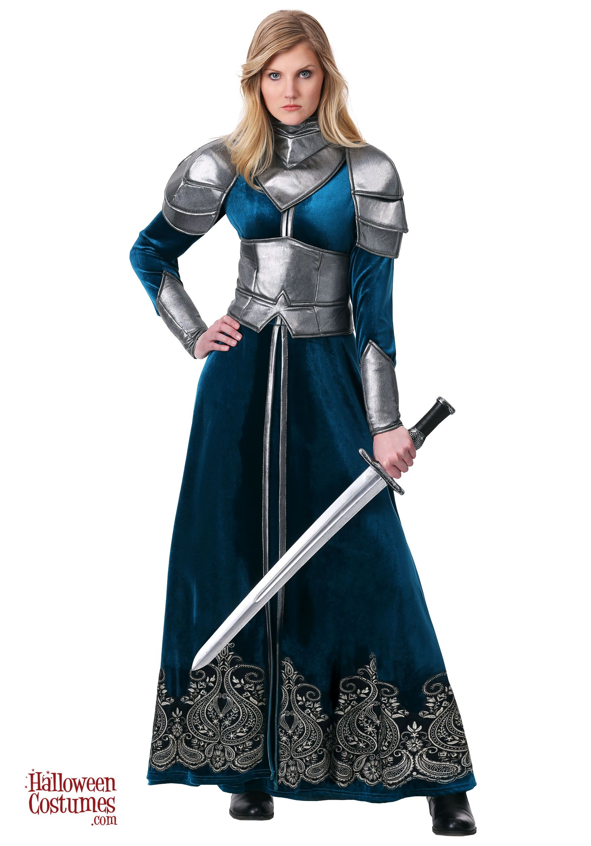

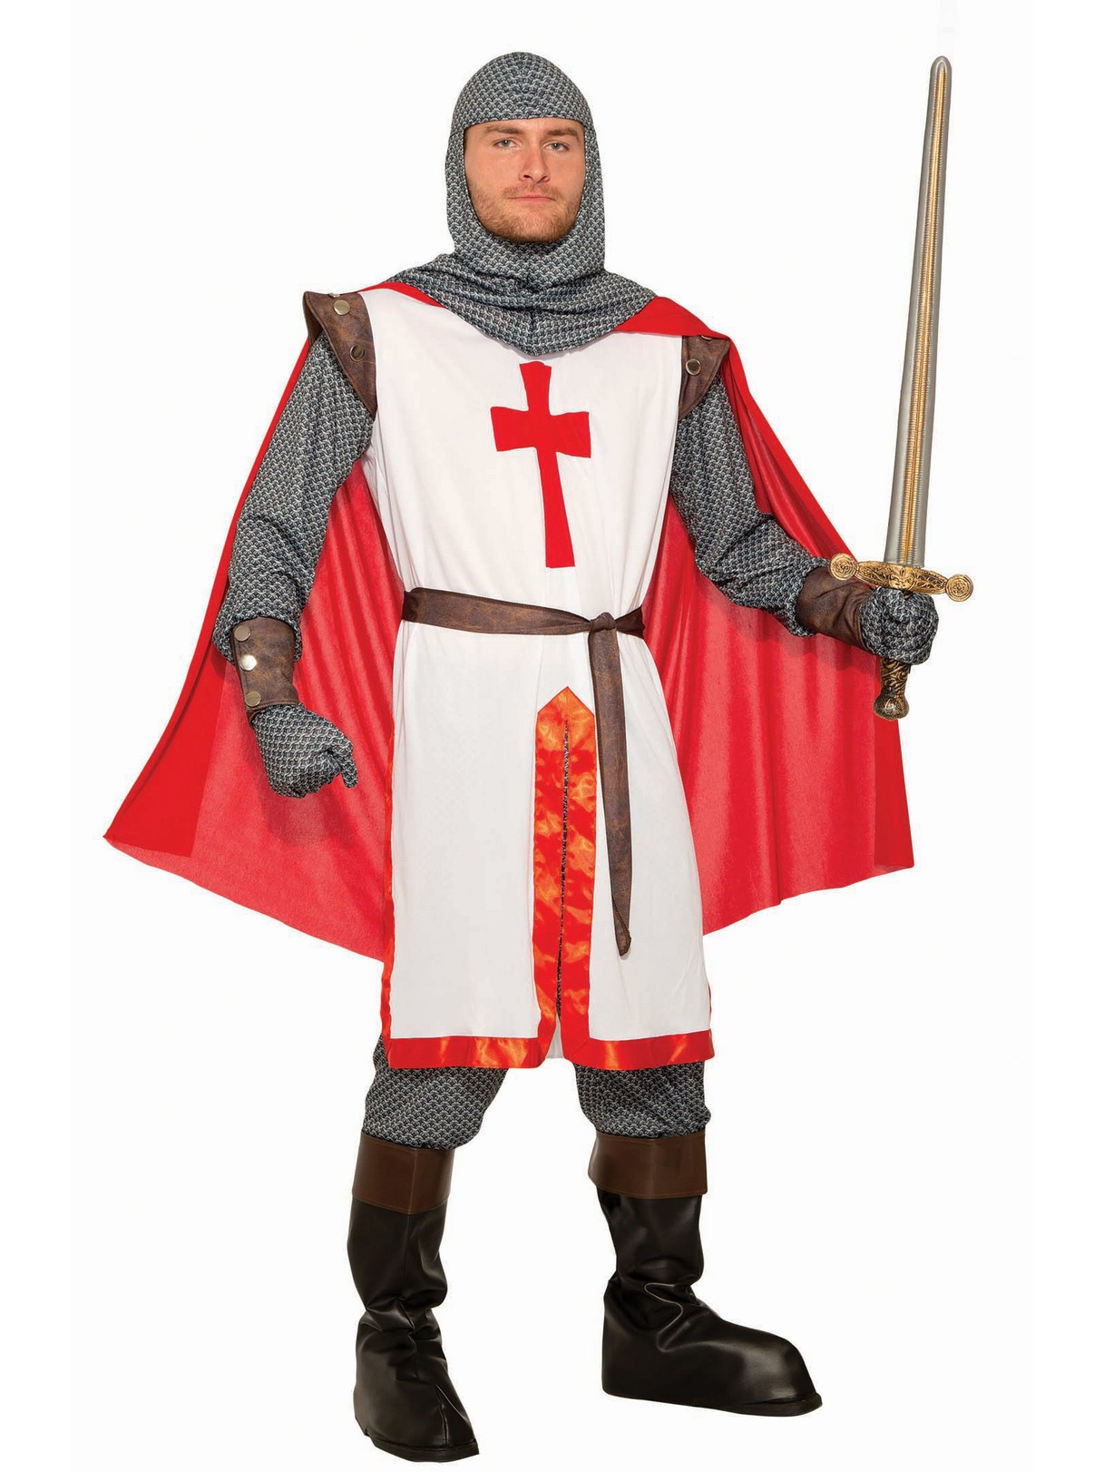
Wardrobe, Props, Makeup
Video Two, Scene Two: Students creating their film

Slide 23
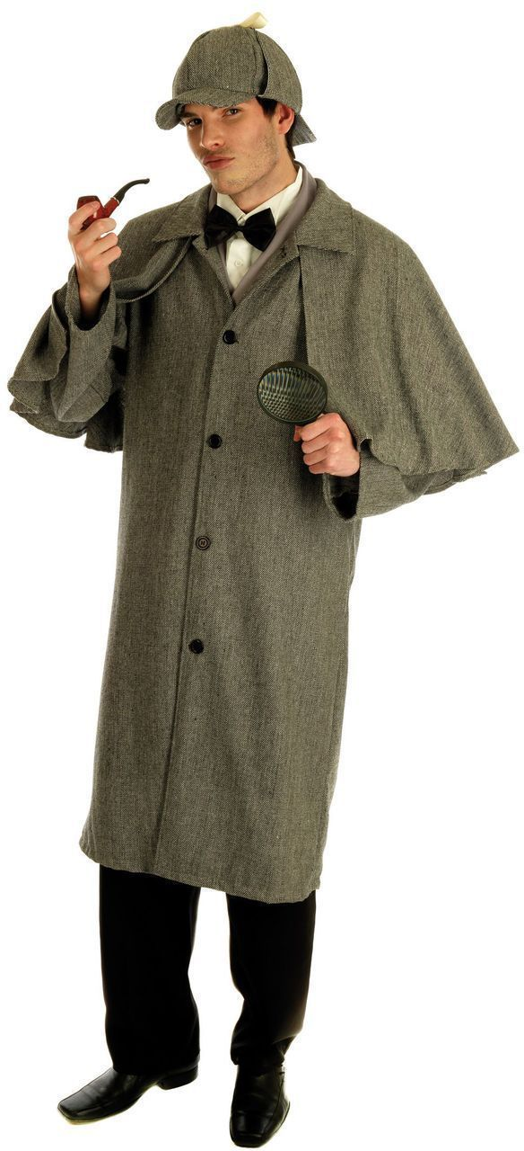
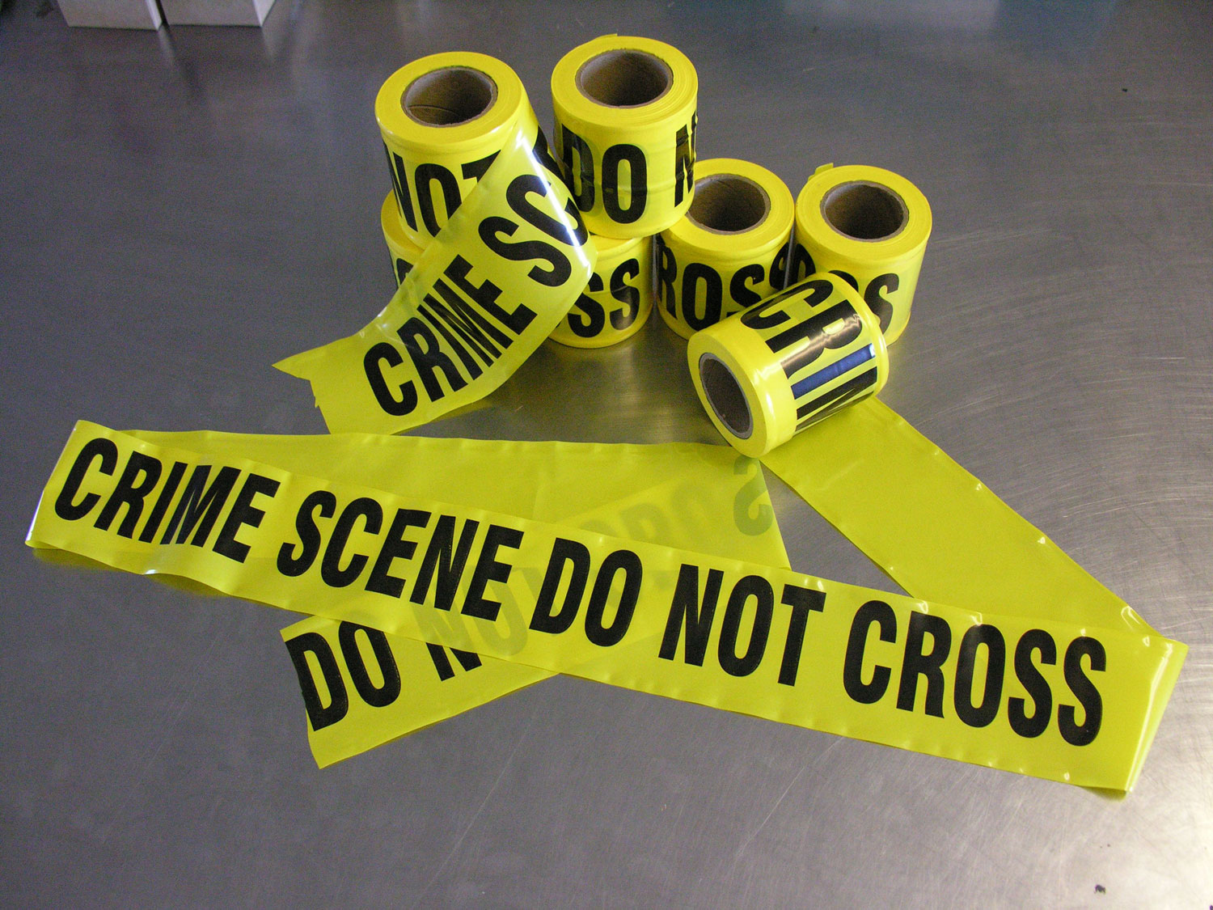
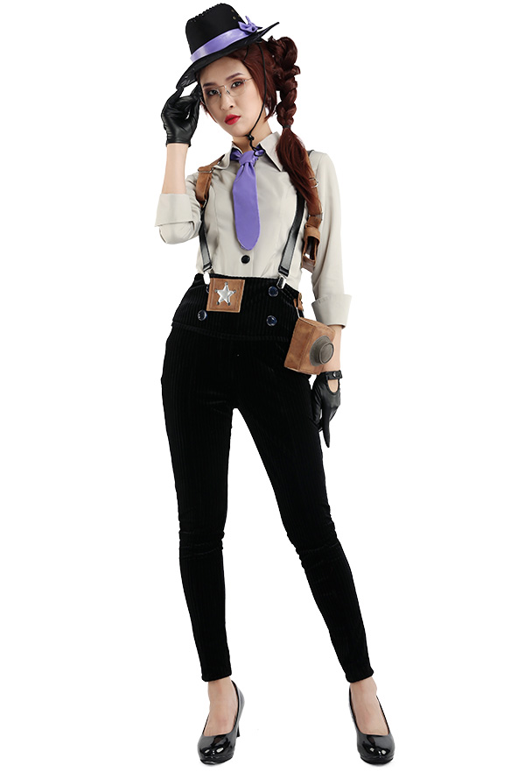
Wardrobe, Props, Makeup
Video Three, Scene Two: Students creating their film

Slide 24
Locations
Video One: Just a fireworks piece
Video Two: CC auditorium, Laura Lander Field and Stage
Video Three: Lander University, Greenwood Elementary

Slide 25
In Summary

Slide 26
Conclusion
This campaign is designed to start earlier than the 2024 campaign in order to generate more interest, competitors, and ticket sales than the 2024 14th Annual Festival. The social media reels and posts will be the main focus, but there will be a flyer for newspaper, as well as a few designs for around town and around campus to catch the attention of a film student or a film-interested adult. Thank you for this opportunity from the Bearcat Cinematics team.

